Slide 1
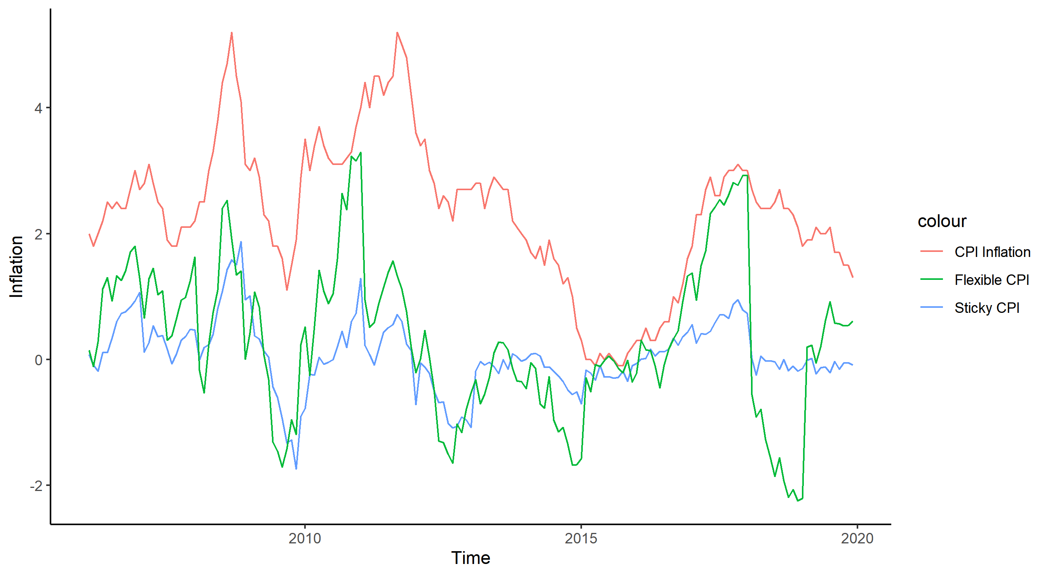

Slide 2
4
2
colour
Inflation
CPI Inflation
Flexible CPI
Sticky CPI
0
-2
2010
2015
2020
Time

